Slide 1
VetBot
Supporting veterans through AI chat and innovative visualisation

Slide 2

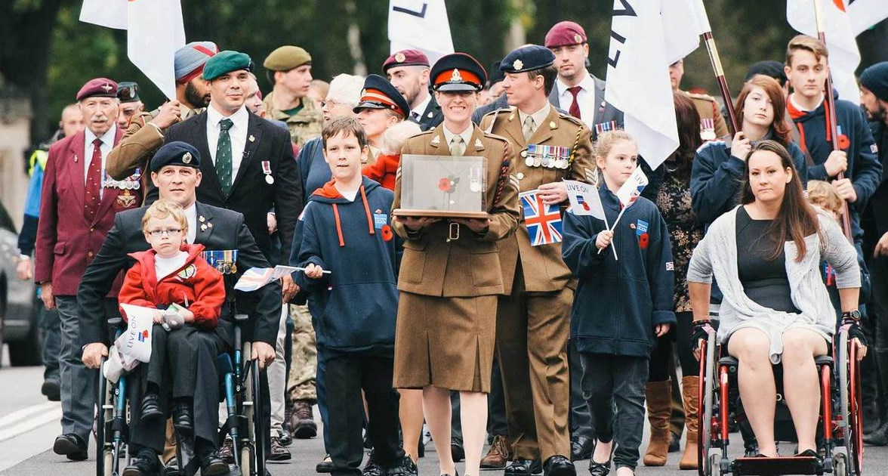


Our
CHallenge
DIVERSE AUDIENCES
VetBot
VETERAN POPULATION
FOUR THEMES
GEOGRAPHIC GRANULARITY
Notes:
Problem statement (why)
Compare Veteran Population with General Population
Offering greater Geographic Granularity of Analysis
Across Four Themes:
Health
Education
Employment
Housing
Identify Areas of Inequality
Audience: Local Councilteam at the MoD receive many requests from different bodies requesting information about veterans. These people
Doctors
MP’s
Individuals
Families
Veterans

Slide 3

What is Vetbot?
Notes:
Vetbot is a conversational AI chatbot that interprets natural language questions of veteran data and allows interactive visualisation of the results

Slide 4


How does it work?
Visualisation
VetBot
ONS data
Analytics engine
Web Based User Interface
Veteran data
ISS data
Open data
Social data
Watson Conversation

Slide 5

Vetbot DEMO
Notes:
Vetbot is a conversational AI chatbot that interprets natural language questions of veteran data and allows interactive visualisation of the results

Slide 6



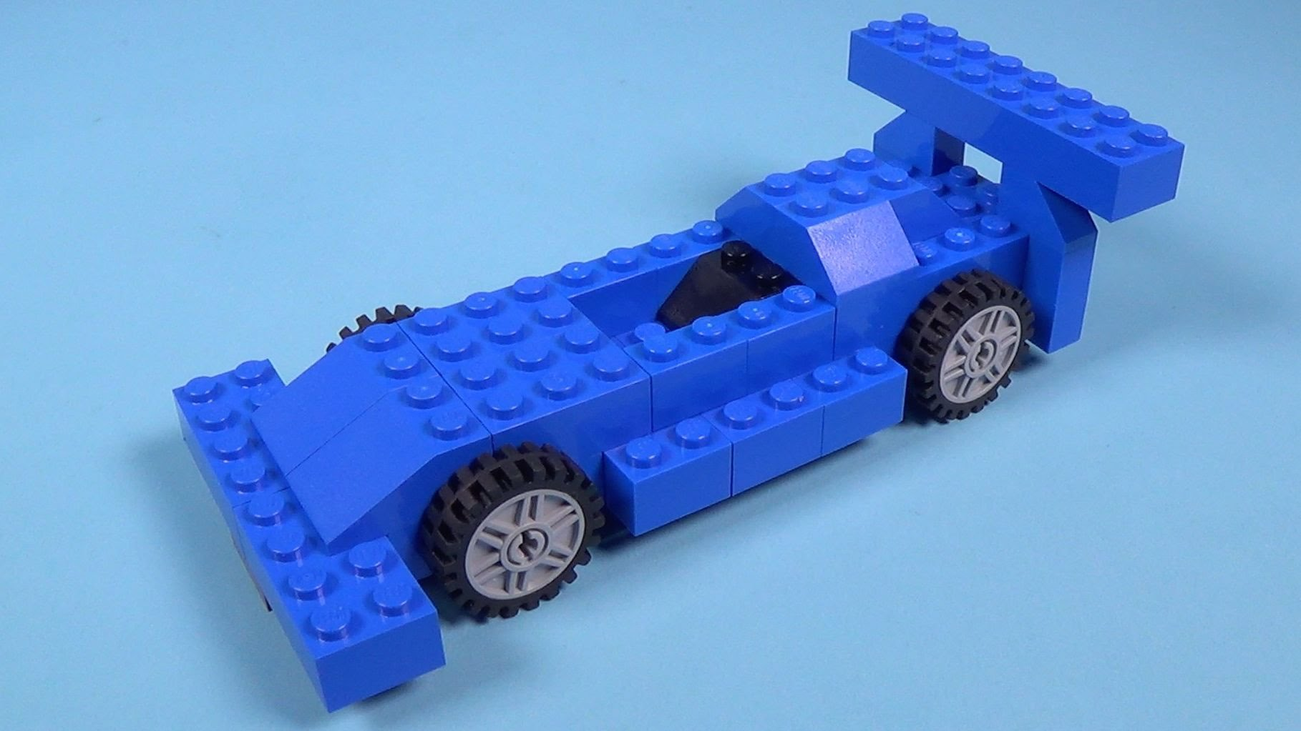
What’s
NEXT?
VetBot
IMPROVE
SECURITY
REFINED
ANALYTICS
DATA
ACCURACY VOLUME
SCALE
AND REUSE
Notes:
Improve data collection.
Obtain the raw data. In this instance, aggregate data has been provided.
Obtain additional datasets, increasing functionality and accuracy.
Provide an export function allowing users the ability produce their own aggregate data.
Improve the security model.
The added complexity of security has not been delivered in this PoC, but has been considered.
An additional audit trail would be beneficial.

Slide 7

VetBot

